Slide 1
Next Up:
Björn Sundling

Slide 2
3
3

Slide 3
2

Slide 4
1

Slide 5
DevOpsCeption Managing Azure DevOps using PowerShell and Azure DevOps
Björn Sundling

Slide 6

Many thanks to our sponsors:

Slide 7

Björn Sundling
@
GitHub.com/bjompen
Mastodon.nu/@bjompen
bjompen.com
Consultant @ Advania Sweden
MVP, MCT, Certified, and more
DevOps and PowerShell nerd lover
Enjoys puzzles and Azure DevOps…
..But is really bad at jigsaw puzzles!

Slide 8
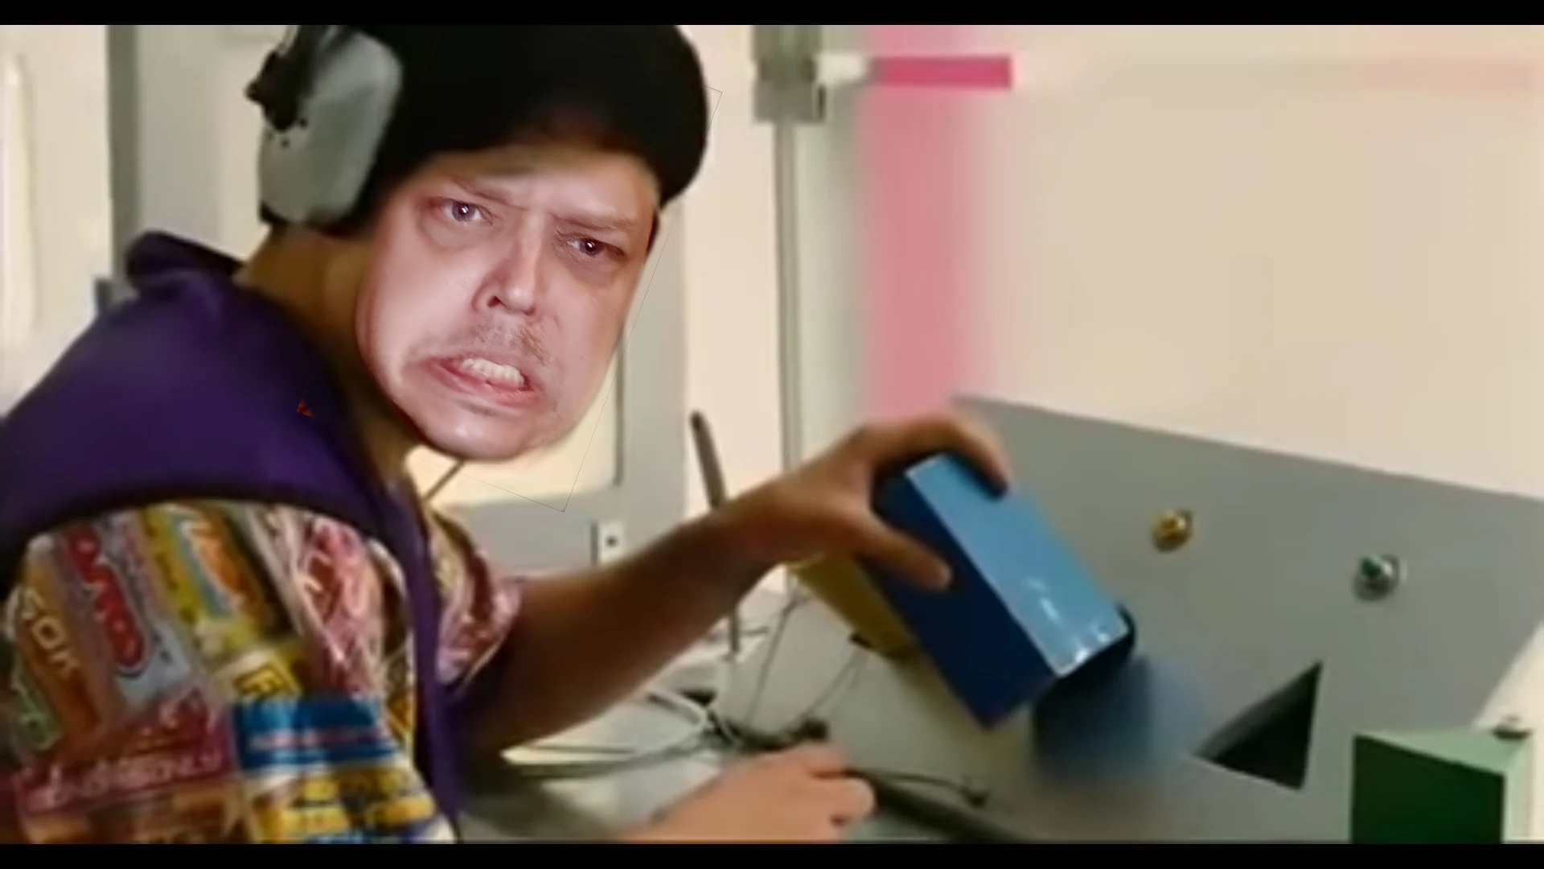


Slide 9
Piece 1 - The API
Been around since forever
Well explored and lots of internet info.
Fully compliant REST api
Including Options
And in some cases examples
Notes:
Examples – Git -> Commits -> Get

Slide 10
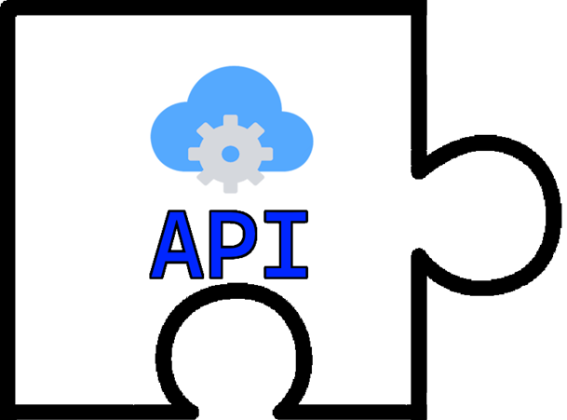

Piece 1 - The API
IT GOES HERE, JUSTIN!
HEY BEN!
WHERE DOES THIS PIECE GO?

Slide 11
Missing pieces…
🤷PATs are bad for you..

Slide 12
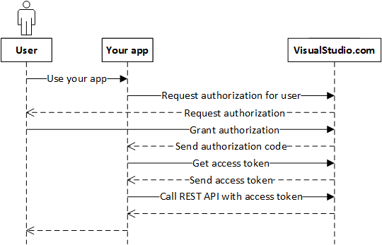
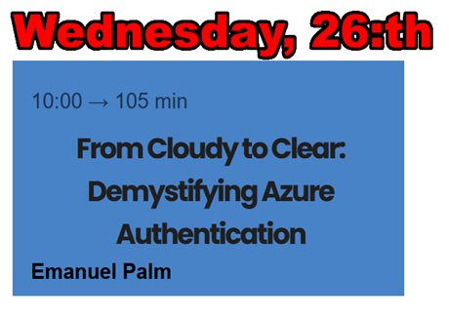
Piece 2 - OAuth
OAuth2
Best Better auth
Hardest auth
Emanuel
Best auth developer
AzAuth
Best auth module

Slide 13
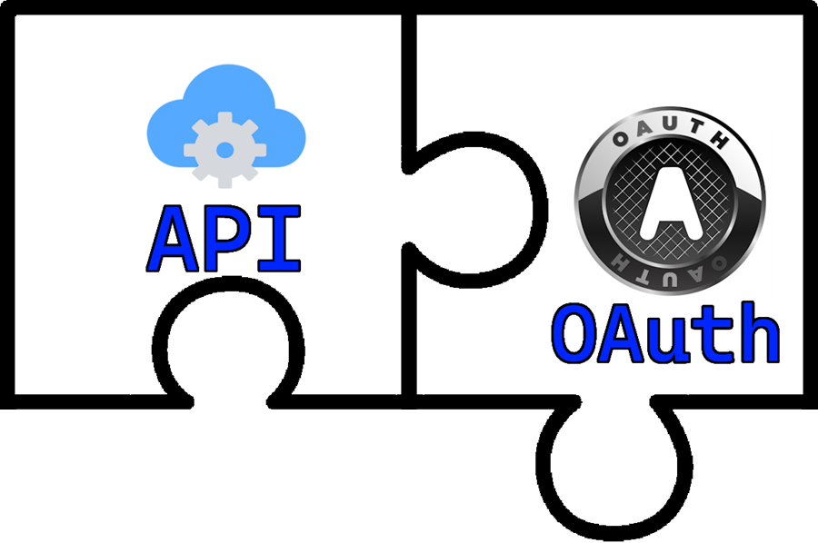

Piece 2 - OAuth
HE SUCKS AT PUZZLES, JUSTIN. HE SAID SO IN SLIDE 1!
JUST PUT IT HERE.
SERIOUSLY?
THERE IS ONLY ONE PLACE TO PUT THIS PIECE.. WHY DO YOU NEED OUR HELP, BJOMPEN?

Slide 14
Missing pieces…
✅PATs are bad for you..
🤷It’s still “personal”. I don’t want to own everything.

Slide 15
Piece 3 - Managed identities
Less personal
Fully supported
Manage DevOps like any other Azure resource.

Slide 16
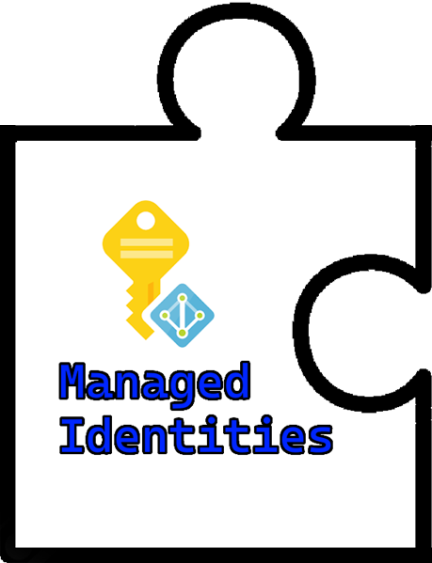
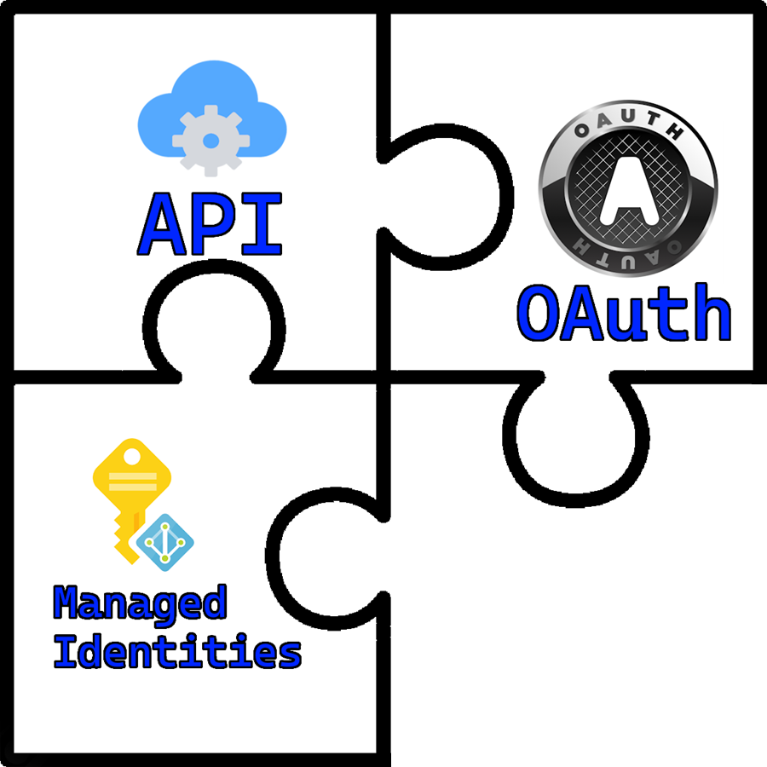
Piece 3 - Managed identities
Doesn’t matter,
We can still do it.
Hey! Isn’t this piece upside down?

Slide 17
Missing pieces…
✅PATs are bad for you..
✅ It’s still “personal”. I don’t want to own everything.
🤷I still need to manage my hosts..
(and set up a service connection..)

Slide 18
Piece 4 -Managed DevOps Pools
Fresh from the oven!
Run public images internally
Connect to internal/private networks
No more installing apps or managing images ☺

Slide 19
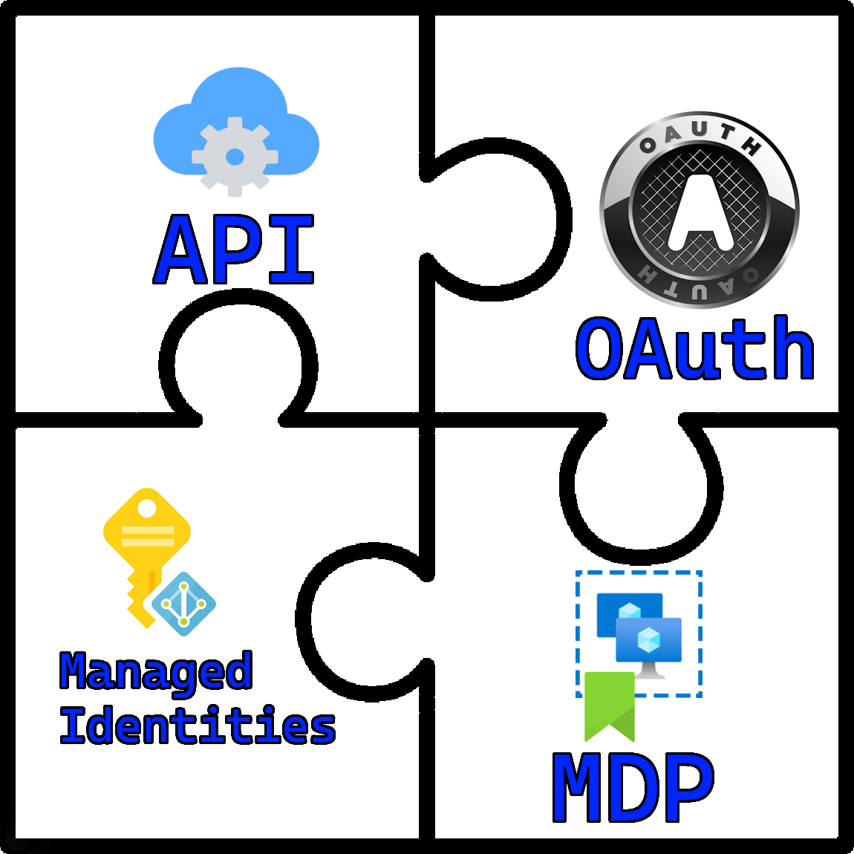
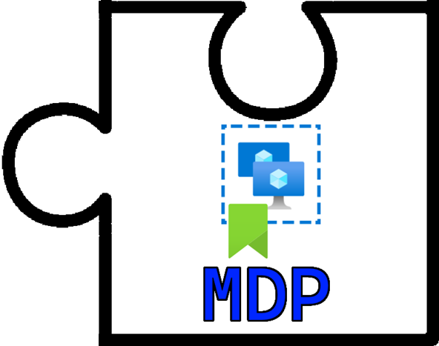
Piece 4 -Managed DevOps Pools
4 Pieces.
He really is bad at puzzles.
Put it here, Bjompen,
And get it done!

Slide 20






Slide 21
Glueing your code to your DevOps again! PowerShell, Json, and Git
A match made in heaven
Json – A first class citizen
GIT – Already keeps track of changes

Slide 22
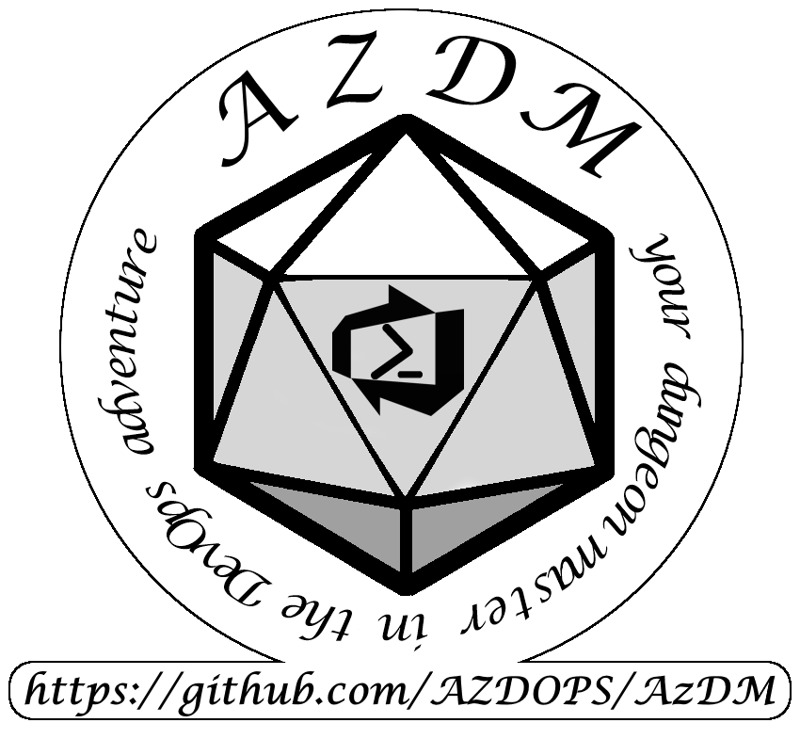
The result!
AzDM
Azure DevOps Manager –or-
Azure Dungeon Master

Slide 23


Slide 24
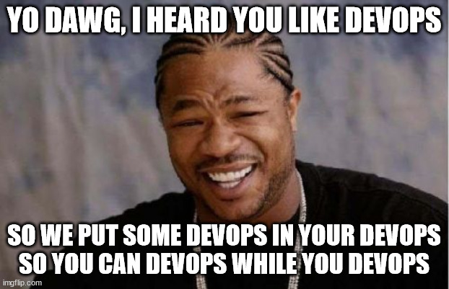

Slide 25
Q&A
15 minutes

